Slide 1

Mallee/Mulga FDI 100 BAL 29
Firebrand movement is shown in this smokeview visual output
A single firebrand (smokeview) represents a number of actual firebrands depending on its size class
The fire and wind flow are not shown

Slide 2
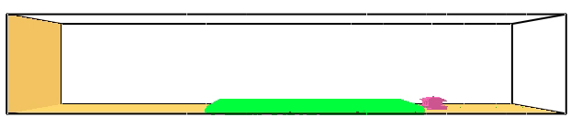
Mallee/Mulga FDI 100 BAL 29
Firebrand movement is shown in this smokeview visual output
A single firebrand (smokeview) represents a number of actual firebrands depending on its size class
The fire is shown

Slide 3
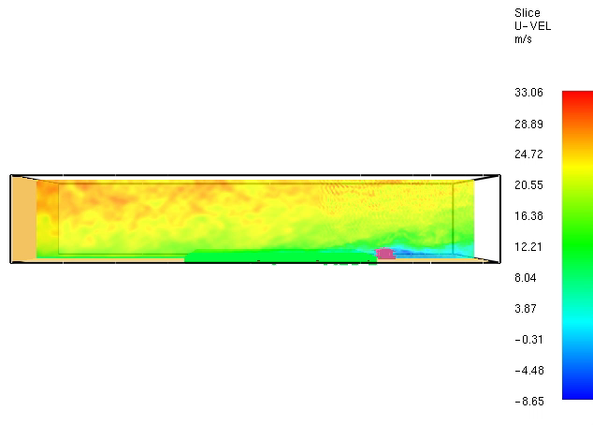
Mallee/Mulga FDI 100 BAL 29
Firebrand movement is shown in this smokeview visual output
A single firebrand (smokeview) represents a number of actual firebrands depending on its size class
The fire and wind flow are shown

